Slide 1
custom Azure DevOps extension
Talk Overview:
Write a Pipeline Task
Build & Test using ADOS
Deploy to VS Market using ADOS
Install & Run Task from Market onto ADOS

Slide 2
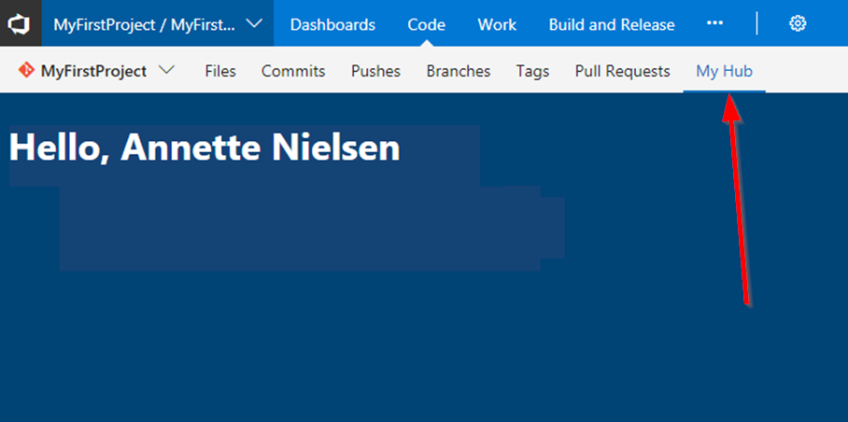
Azure Devops Extensions

Slide 3
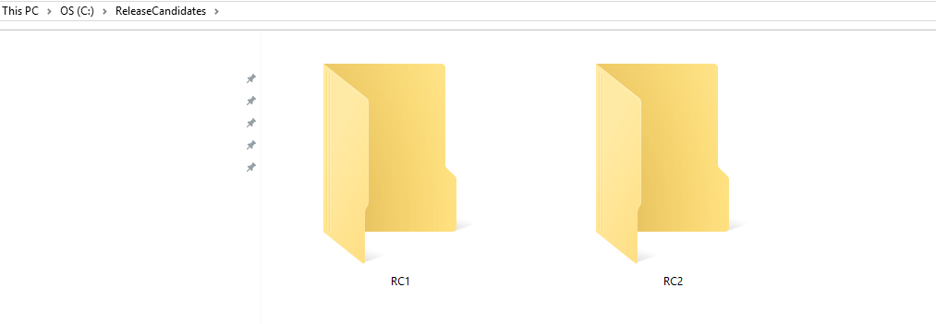
Writing custom pipeline task
Use Case: Azure DevOps Build/Release Task. Set Azure DevOps variable(s) with next folder name incremented from existing names. E.g. RC3, if RC1 & RC2 already exist.
https://github.com/dp7g09/azure-devops-nextfolder
Essential documentation: https://docs.microsoft.com/en-gb/azure/devops/extend/develop/add-build-task?view=azure-devops

Slide 4
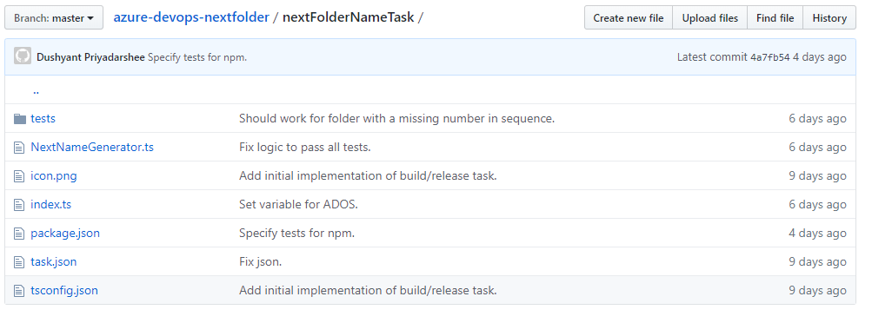
Important files

Slide 5
Important files

Slide 6
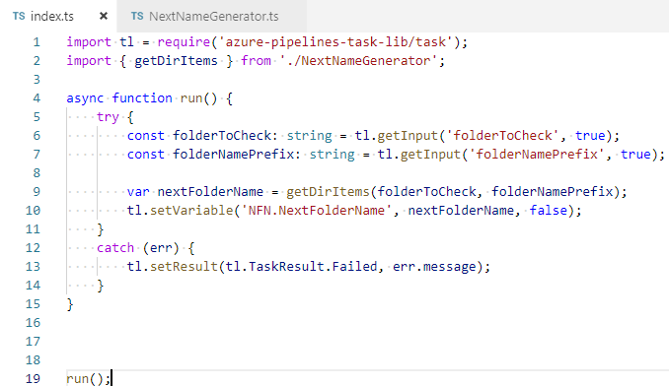

Slide 7
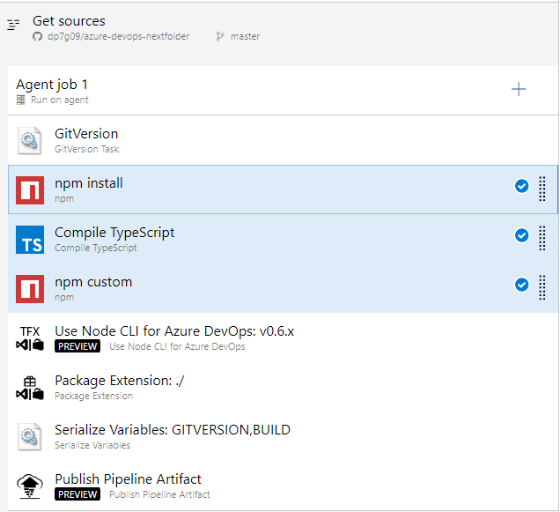
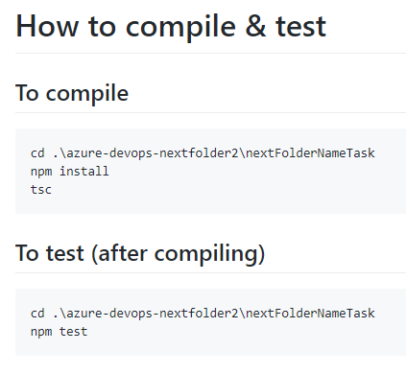
CI-CD With Azure Devops

Slide 8
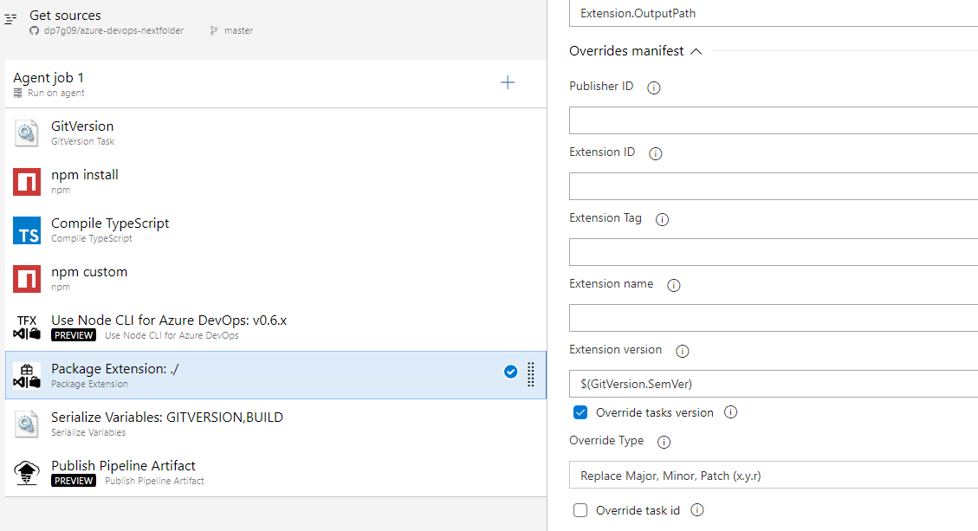
Versioning

Slide 9
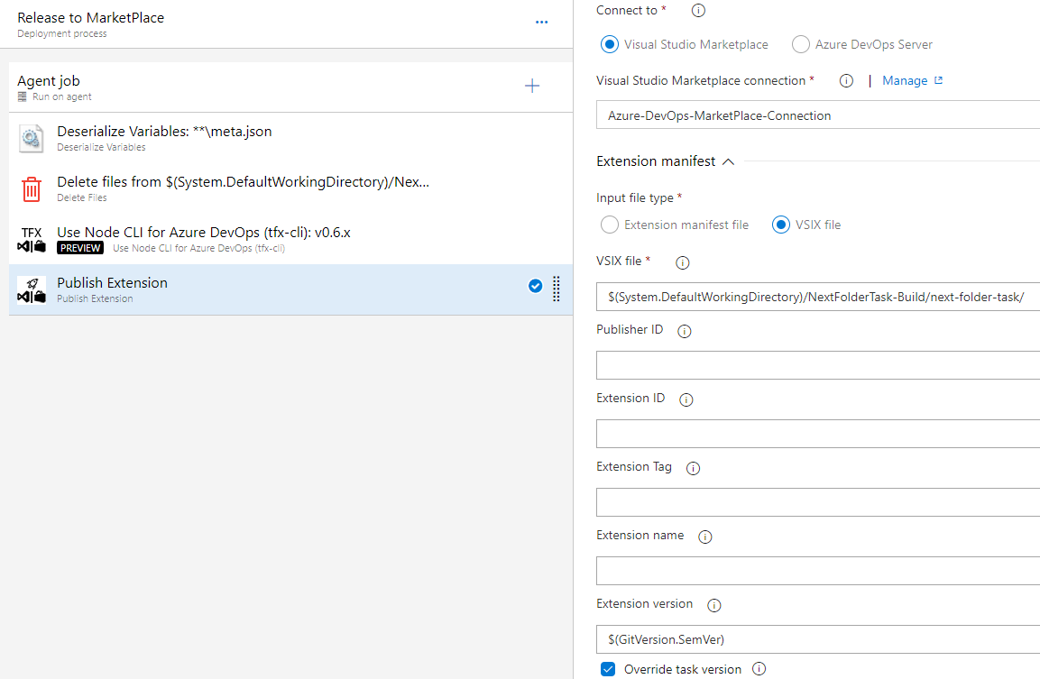
Release to marketplace

Slide 10
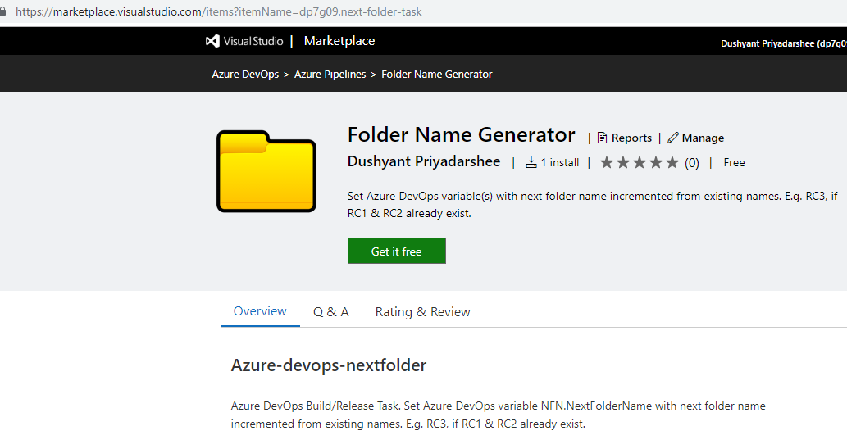
Testing our extension

Slide 11
Testing our extension

Slide 12
Testing our extension

Slide 13
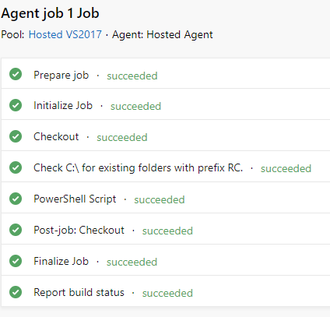
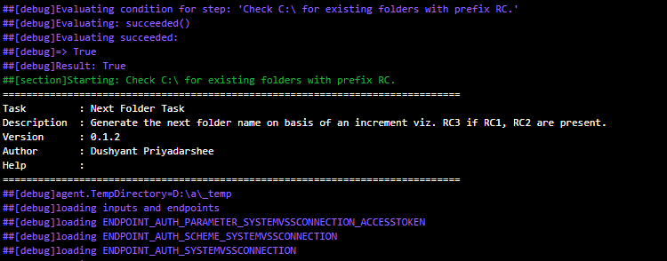
Testing our extension

Slide 14
Thank You
Dushyant Priyadarshee
Twitter: @dp7g09
Github: https://github.com/dp7g09

