Slide 1
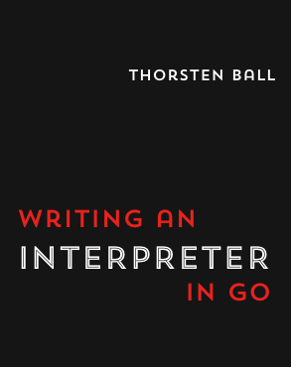
Writing an Interpreter in GO C#
Tim Boyle
.Net Oxford
14th May 2019
interpreterbook.com
Notes:
Good evening. My name is Tim Boyle and I am going to talk to you about some basic interpreter theory that I have gleaned from this book
Build up interpreter
Why Go?
In C# - not going to talk
Apologise if title misleading
But if you are interested – get the book!

Slide 2

Overview
Roslyn API Template
Syntax Visualizer
Simple Interpreter
Code Fixes
Notes:
DotNet centric
focus - how the theory can help
Roslyn Analyser or Code Fix
DotNet Compiler Platform
C# in C#
Powerful API
manipulate codebase

Slide 3


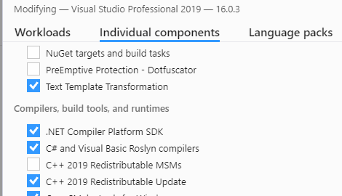
Roslyn SDK
Notes:
A little Faff
Visual Studio Component

Slide 4
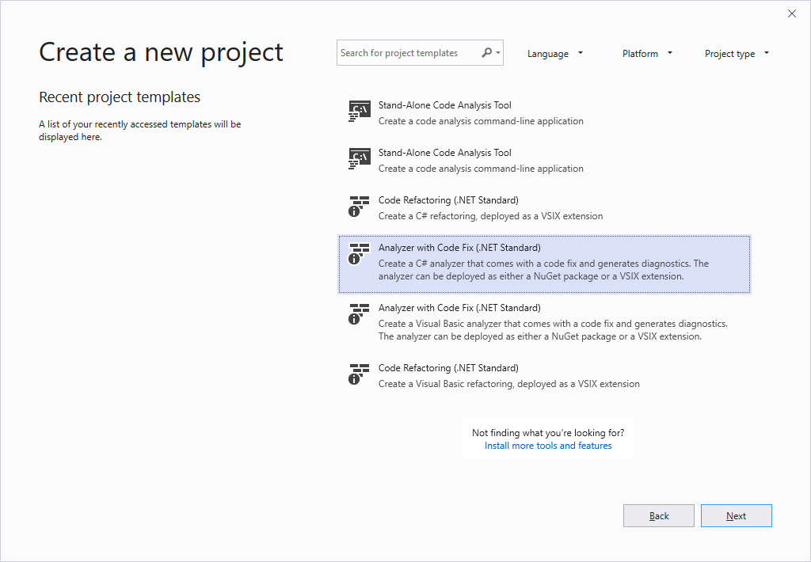
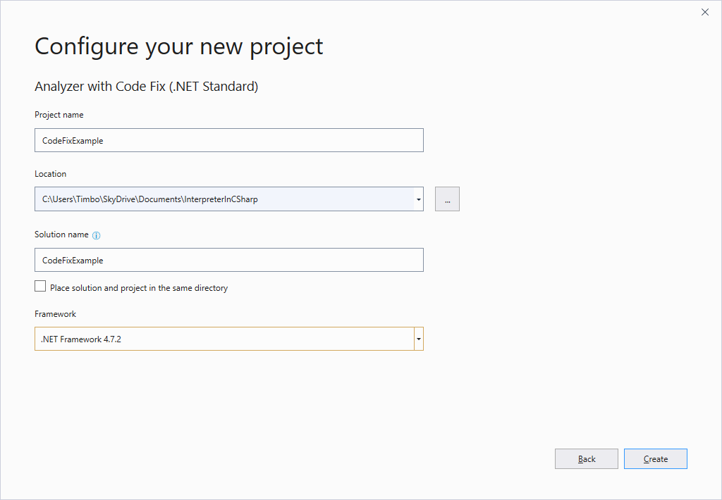
Template
Notes:
new Analyser
give errors or warnings
suggest refactorings
Enforcing coding standards – suggesting patterns
StyleCop (NuGet / VS Extension)

Slide 5
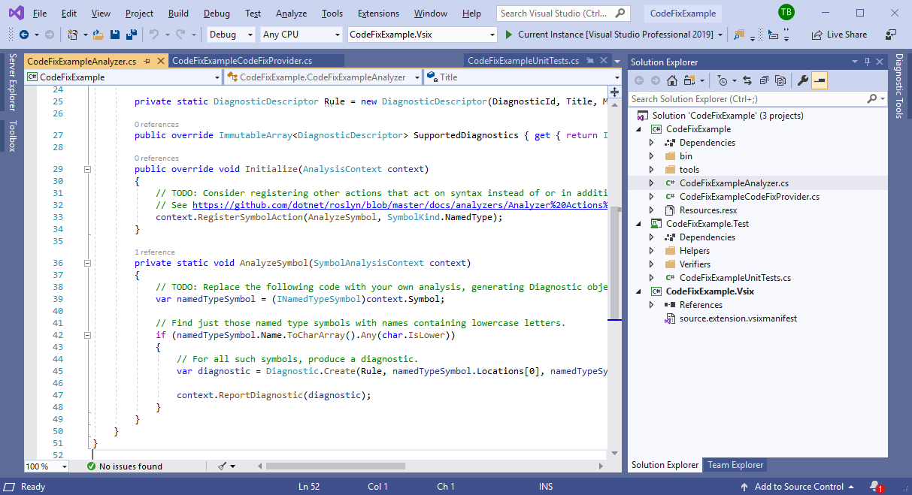
Code Fixes / Analyzers
Notes:
Template includes
Example Analyser
Example Code Fix
Unit test project

Slide 6
Code Fixes / Analyzers
Notes:
boilerplate
two lines that are important.
register / action
Not a real world example!
Run (nothing changed) -> second VS instance

Slide 7
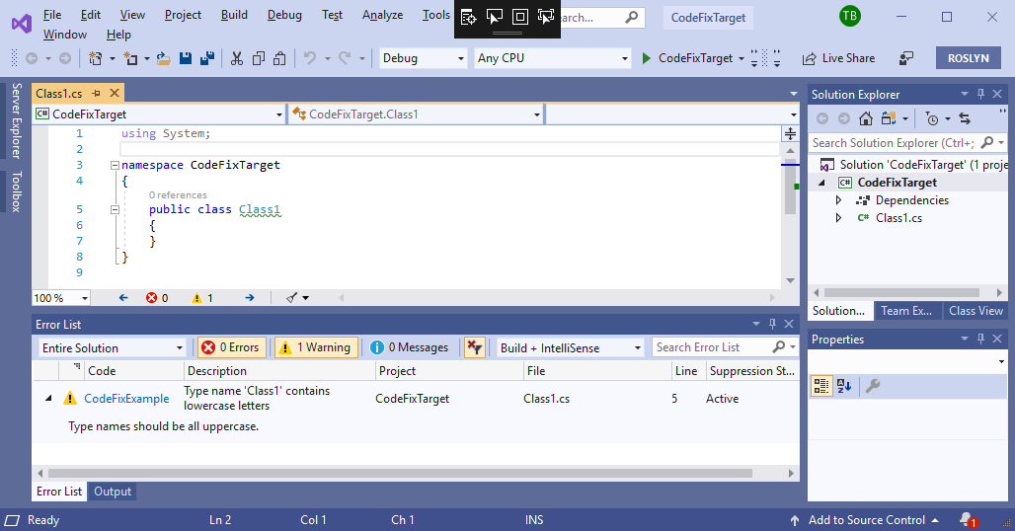
Code Fixes / Analyzers
Notes:
dotnet standard class library.
compiler warning from our analyser
Wavey green line

Slide 8
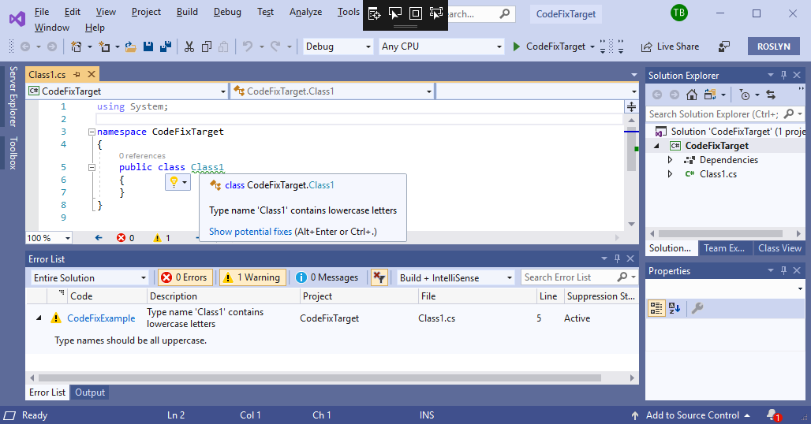
Code Fixes / Analyzers
Notes:
hover = custom message

Slide 9
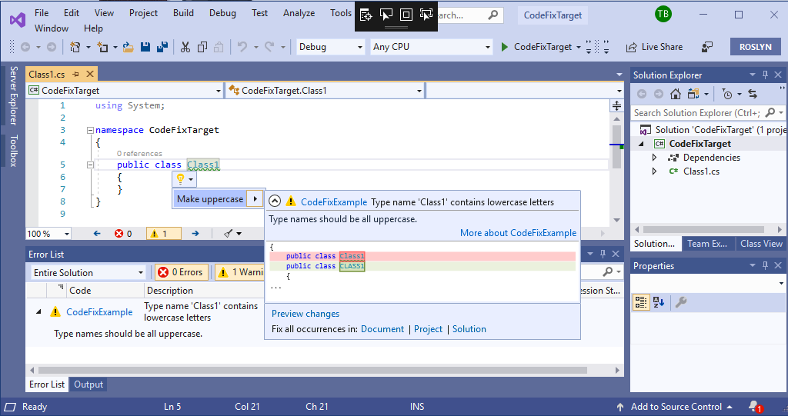
Code Fixes / Analyzers
Notes:
Click lightbulb => suggest refactoring

Slide 10
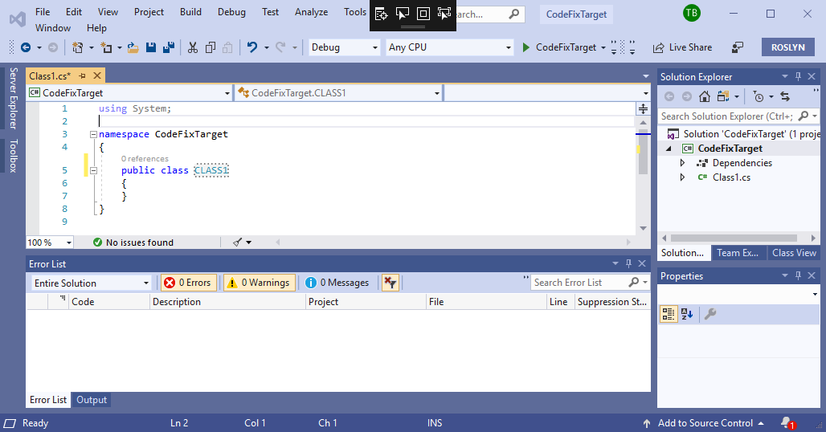
Code Fixes / Analyzers
Notes:
Fix
Just example ☺

Slide 11
Code Fixes / Analyzers
Notes:
modifying template
detect other issues.
Add refactoring
Query AST to find problem

Slide 12
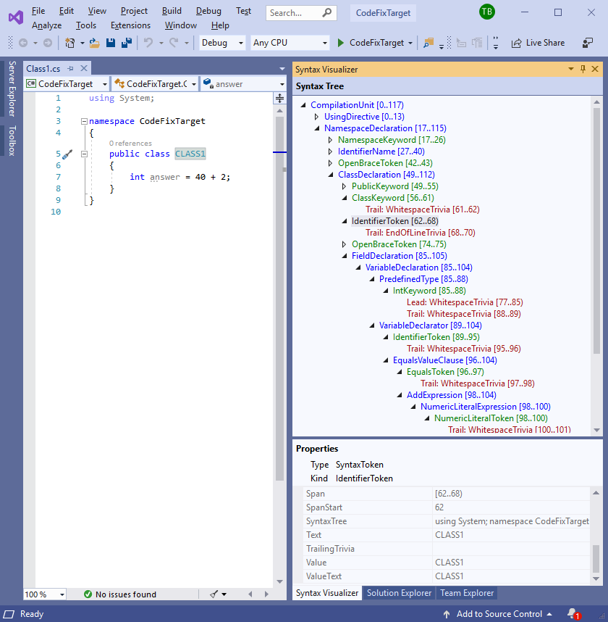
Syntax Visualizer
Notes:
VS component gives Syntax Visualizer.
Before / After
See RGB nodes
What is tree?
dig into theory

Slide 13
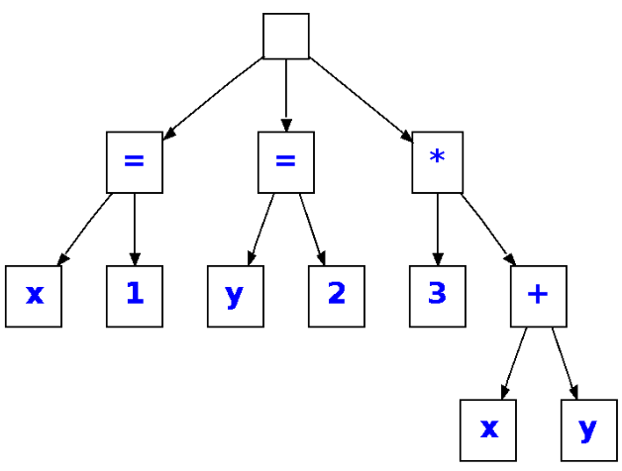


Interpreter
Source Code
Tokens
Abstract Syntax
Tree (AST)
Evaluation
Lexical Analysis
Parsing
This Photo by Unknown Author is licensed under CC BY-SA
Notes:
This is where our book comes in.
how does source code run
Evaluation – Chris Bacon (IL runtime)
Form easy for computer to understand
Two steps

Slide 14
Lexical Analysis
Chop up text into pieces which are more meaningful to the parser
These pieces are called tokens

Slide 15

Lexing
let answer = 40 + 2;
Notes:
Running through Example
Monkey: Specifically designed, essential concepts

Slide 16
Lexing
let answer = 40 + 2;
Notes:
step through text file
First character
special characters : semicolon, braces, brackets
identifier

Slide 17
Lexing
let answer = 40 + 2;
Notes:
compare against a set of keywords.

Slide 18
Lexing
LET
let answer = 40 + 2;
Notes:
LET keyword -> token
Addition information stored

Slide 19
Lexing
LET
let answer = 40 + 2;
Notes:
Whitespace
Python

Slide 20
Lexing
LET
let answer = 40 + 2;
Notes:
identifier.
Not keyword

Slide 21
Lexing
LET
IDENTIFIER("answer")
let answer = 40 + 2;
Notes:
name not important - parsing
evaluation

Slide 22
Lexing
LET
IDENTIFIER("answer")
let answer = 40 + 2;
Notes:
equals sign - special character.

Slide 23
Lexing
LET
IDENTIFIER("answer")
EQUAL_SIGN
let answer = 40 + 2;

Slide 24
Lexing
LET
IDENTIFIER("answer")
EQUAL_SIGN
let answer = 40 + 2;
Notes:
NOT special character.
CAN’T be an identifier
Only integers supported

Slide 25
Lexing
LET
IDENTIFIER("answer")
EQUAL_SIGN
let answer = 40 + 2;

Slide 26
Lexing
LET
IDENTIFIER("answer")
EQUAL_SIGN
INTEGER(40)
let answer = 40 + 2;
Notes:
40 not important - parser
evaluation

Slide 27
Lexing
LET
IDENTIFIER("answer")
EQUAL_SIGN
INTEGER(40)
let answer = 40 + 2;
Notes:
Another special character.

Slide 28
Lexing
LET
IDENTIFIER("answer")
EQUAL_SIGN
INTEGER(40)
PLUS_SIGN
let answer = 40 + 2;
Notes:
plus sign token

Slide 29
Lexing
LET
IDENTIFIER("answer")
EQUAL_SIGN
INTEGER(40)
PLUS_SIGN
let answer = 40 + 2;
Notes:
Another number.

Slide 30
Lexing
LET
IDENTIFIER("answer")
EQUAL_SIGN
INTEGER(40)
PLUS_SIGN
INTEGER(2)
let answer = 40 + 2;
Notes:
Nearly there

Slide 31
Lexing
LET
IDENTIFIER("answer")
EQUAL_SIGN
INTEGER(40)
PLUS_SIGN
INTEGER(2)
let answer = 40 + 2;
Notes:
last character - semicolon

Slide 32
Lexing
LET
IDENTIFIER("answer")
EQUAL_SIGN
INTEGER(40)
PLUS_SIGN
INTEGER(2)
SEMICOLON
let answer = 40 + 2;
Notes:
Has own token
Great, end of the program.

Slide 33
Lexing
LET
IDENTIFIER("answer")
EQUAL_SIGN
INTEGER(40)
PLUS_SIGN
INTEGER(2)
SEMICOLON
let answer = 40 + 2;
Notes:
not quite done with tokens.
Denote End

Slide 34
Lexing
LET
IDENTIFIER("answer")
EQUAL_SIGN
INTEGER(40)
PLUS_SIGN
INTEGER(2)
SEMICOLON
EOF
let answer = 40 + 2;
Notes:
End of File

Slide 35
Lexing
LET
IDENTIFIER("answer")
EQUAL_SIGN
INTEGER(40)
PLUS_SIGN
INTEGER(2)
SEMICOLON
EOF
let answer = 40 + 2;
Notes:
end of the example
not necessary valid
tokens ready -> input
next stage – Parsing

Slide 36
Parsing
Parser takes input data and builds
a data structure giving a structural representation of the input, checking
for correct syntax in the process.
Wikipedia
Notes:
parsing step : tokens -> AST
2 main strategies (Top Down , Bottom Up)
Recursive Descent Parser
Specifically: Top Down Operator Precedence parser.

Slide 37
Parsing
let answer = 40 + 2;
Notes:
Continue example.
first section : raw text -> set of tokens

Slide 38
Parsing
let answer = 40 + 2;
LET
IDENTIFIER("answer")
EQUAL_SIGN
INTEGER(40)
PLUS_SIGN
INTEGER(2)
SEMICOLON
EOF
Notes:
transform : tokens -> more structured representation.

Slide 39
Parsing
let answer = 40 + 2;
Program
LET
IDENTIFIER("answer")
EQUAL_SIGN
INTEGER(40)
PLUS_SIGN
INTEGER(2)
SEMICOLON
EOF
Statements[]
Notes:
top down
start constructing root node AST
This represents the entire program.
create nodes for statements.

Slide 40
Parsing
let answer = 40 + 2;
Program
LET
IDENTIFIER("answer")
EQUAL_SIGN
INTEGER(40)
PLUS_SIGN
INTEGER(2)
SEMICOLON
EOF
Statements[]
LetStatement
Name
Value
Notes:
Create node – recurse
Expects: Let, identifier, equals, expression

Slide 41
Parsing
let answer = 40 + 2;
Program
LET
IDENTIFIER("answer")
EQUAL_SIGN
INTEGER(40)
PLUS_SIGN
INTEGER(2)
SEMICOLON
EOF
Statements[]
LetStatement
Name
Value
Identifier
Value
Notes:
Create identifier node
Recurse

Slide 42
Parsing
let answer = 40 + 2;
Program
LET
IDENTIFIER("answer")
EQUAL_SIGN
INTEGER(40)
PLUS_SIGN
INTEGER(2)
SEMICOLON
EOF
Statements[]
LetStatement
Name
Value
Identifier
Value : "answer"
Notes:
Grabs variable name
control returned to Let
Equals sign : Not represented, error

Slide 43
Parsing
let answer = 40 + 2;
Program
LET
IDENTIFIER("answer")
EQUAL_SIGN
INTEGER(40)
PLUS_SIGN
INTEGER(2)
SEMICOLON
EOF
Statements[]
LetStatement
Name
Value
Identifier
Value : "answer"
Notes:
Now need a expression to assign.
Slightly more complex - process the whole expression
gloss over details
arrange nodes, as they come in, based on operator precedence.

Slide 44
Parsing
let answer = 40 + 2;
Program
LET
IDENTIFIER("answer")
EQUAL_SIGN
INTEGER(40)
PLUS_SIGN
INTEGER(2)
SEMICOLON
EOF
Statements[]
LetStatement
Name
Value
Identifier
Value : "answer"
IntegerLiteral
Value: 40
Notes:
Create node for our 40.

Slide 45
Parsing
let answer = 40 + 2;
Program
LET
IDENTIFIER("answer")
EQUAL_SIGN
INTEGER(40)
PLUS_SIGN
INTEGER(2)
SEMICOLON
EOF
Statements[]
LetStatement
Name
InfixExpression
Value
LHS
Identifier
RHS
Value : "answer"
IntegerLiteral
Value: 40
Notes:
Create node for our +

Slide 46
Parsing
let answer = 40 + 2;
Program
LET
IDENTIFIER("answer")
EQUAL_SIGN
INTEGER(40)
PLUS_SIGN
INTEGER(2)
SEMICOLON
EOF
Statements[]
LetStatement
Name
InfixExpression
Value
LHS
Identifier
RHS
Value : "answer"
IntegerLiteral
Value: 40
Notes:
Plus has higher operator precedence
becomes parent.
root of the expression is now the plus.

Slide 47
Parsing
let answer = 40 + 2;
Program
LET
IDENTIFIER("answer")
EQUAL_SIGN
INTEGER(40)
PLUS_SIGN
INTEGER(2)
SEMICOLON
EOF
Statements[]
LetStatement
Name
InfixExpression
Value
LHS
Identifier
RHS
Value : "answer"
IntegerLiteral
IntegerLiteral
Value: 40
Value: 2
Notes:
Create our 2
lower precedence
root remains the same.

Slide 48
Parsing
let answer = 40 + 2;
Program
LET
IDENTIFIER("answer")
EQUAL_SIGN
INTEGER(40)
PLUS_SIGN
INTEGER(2)
SEMICOLON
EOF
Statements[]
LetStatement
Name
InfixExpression
Value
LHS
Identifier
RHS
Value : "answer"
IntegerLiteral
IntegerLiteral
Value: 40
Value: 2
Notes:
semicolon terminates the expression.
Attach root

Slide 49
Parsing
let answer = 40 + 2;
Program
LET
IDENTIFIER("answer")
EQUAL_SIGN
INTEGER(40)
PLUS_SIGN
INTEGER(2)
SEMICOLON
EOF
Statements[]
LetStatement
Name
InfixExpression
Value
LHS
Identifier
RHS
Value : "answer"
IntegerLiteral
IntegerLiteral
Value: 40
Value: 2
Notes:
control passed to Program
starts looking for another statement.

Slide 50
Parsing
let answer = 40 + 2;
Program
LET
IDENTIFIER("answer")
EQUAL_SIGN
INTEGER(40)
PLUS_SIGN
INTEGER(2)
SEMICOLON
EOF
Statements[]
LetStatement
Name
InfixExpression
Value
LHS
Identifier
RHS
Value : "answer"
IntegerLiteral
IntegerLiteral
Value: 40
Value: 2
Notes:
next token – EOF
so we know we are finished!
The Abstract Syntax Tree is complete.

Slide 51
Roslyn
Notes:
So lets try to map this onto our Syntax Visualizer

Slide 52
Syntax Visualizer
let answer = 40 + 2;
LET
IDENTIFIER("answer")
EQUAL_SIGN
INTEGER(40)
PLUS_SIGN
INTEGER(2)
SEMICOLON
EOF
Notes:
tokens back up again.
transpile : Monkey -> C#

Slide 53
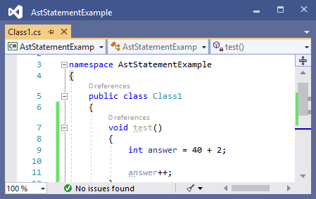
Syntax Visualizer
int answer = 40 + 2;
INT
IDENTIFIER("answer")
EQUAL_SIGN
INTEGER(40)
PLUS_SIGN
INTEGER(2)
SEMICOLON
EOF
Notes:
Yep just change let to int

Slide 54
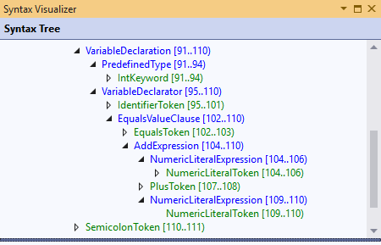
Visual Studio
int answer = 40 + 2;
INT
IDENTIFIER("answer")
EQUAL_SIGN
INTEGER(40)
PLUS_SIGN
INTEGER(2)
SEMICOLON
EOF
Notes:
visualizer alongside
good match

Slide 55
Visual Studio
INT
IDENTIFIER("answer")
EQUAL_SIGN
INTEGER(40)
PLUS_SIGN
INTEGER(2)
SEMICOLON
EOF
Notes:
Example tokens = green Roslyn tokens

Slide 56
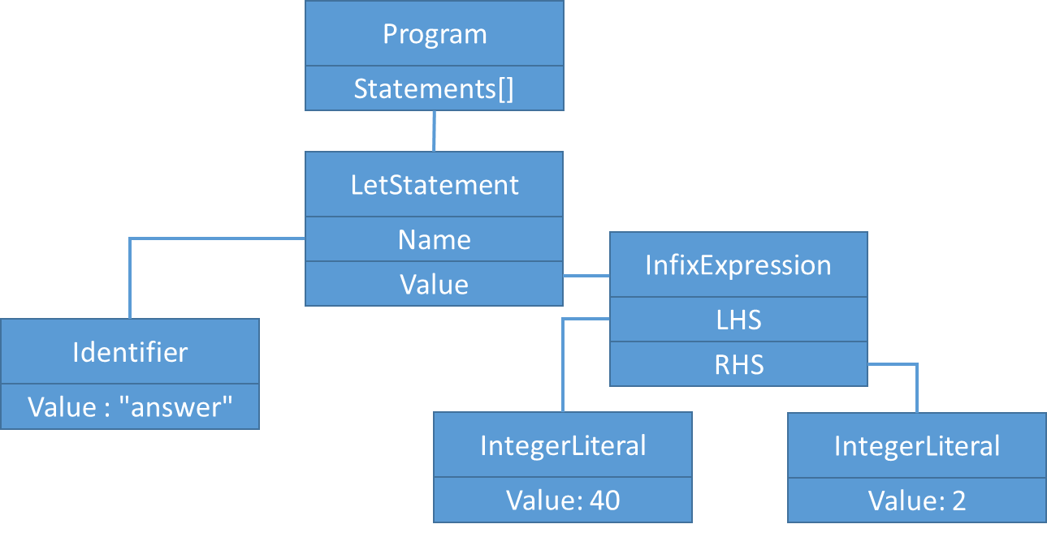
Visual Studio
int answer = 40 + 2;
Notes:
parse tree = blue tree nodes.

Slide 57
Syntax Visualizer
Notes:
initial screen shot.
red entries – Trivia (whitespace, comments)
Roslyn : parse nodes link tokens
Properties – span, link trivia

Slide 58
Code Fixes
Notes:
Finish with a quick example of a tree modification

Slide 59
Abstract Syntax Tree
let answer = 40 + 2;
Program
LET
IDENTIFIER("answer")
EQUAL_SIGN
INTEGER(40)
PLUS_SIGN
INTEGER(2)
SEMICOLON
EOF
Statements[]
LetStatement
Name
InfixExpression
Value
LHS
Identifier
RHS
Value : "answer"
IntegerLiteral
IntegerLiteral
Value: 40
Value: 2
Notes:
compiler : tree -> code optimization
applying graph theory
suggest refactorings
small tree - obvious example.

Slide 60
Abstract Syntax Tree
let answer = 40 + 2;
Program
LET
IDENTIFIER("answer")
EQUAL_SIGN
INTEGER(40)
PLUS_SIGN
INTEGER(2)
SEMICOLON
EOF
Statements[]
LetStatement
Name
InfixExpression
Value
LHS
Identifier
RHS
Value : "answer"
IntegerLiteral
IntegerLiteral
Value: 40
Value: 2
Notes:
sub-tree - bottom right : Adding literals
Roslyn : nodes -> token -> characters
editor support = underline, selection of refactorings
This is what our Code Fix Analyser does

Slide 61
Abstract Syntax Tree
let answer = 42;
Program
LET
IDENTIFIER("answer")
EQUAL_SIGN
INTEGER(42)
SEMICOLON
EOF
Statements[]
LetStatement
Name
IntegerLiteral
Value
Value: 42
Identifier
Value : "answer"
Notes:
branch of the tree -> a single literal.

Slide 62
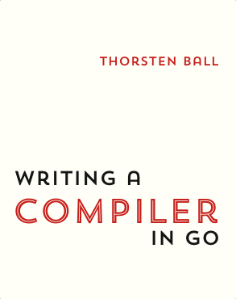

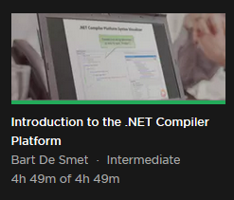
Thank You
interpreterbook.com
compilerbook.com
pluralsight.com
Notes:
Thanks
links to material
https://docs.microsoft.com/en-us/dotnet/csharp/roslyn-sdk/

